Slide 1
Modern Times for Neural Networks
COMP 4230

Slide 2
ALERTS
Assignment #3
Moroney text...
Read Chapters 1 & 2 of Moroney

Slide 3
The 'Over the Horizon' Effect
Has AI generally been optimistic or pessimistic about its future?
What timeline have predictions typically set?
AI Winter
Has actually been a series of different winters
Perceptron winter (1970s)
Symbolic winter (1980s)
Consciousness winter (1990s)

Slide 4
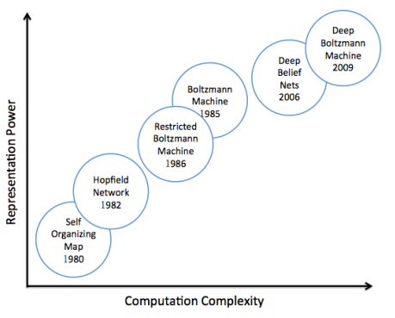
Machine Learning: Neural Nets Wave Three
The biggest challenge for neural network models in the 1980s was computational power.
The computers available simply didn't have the capacity to train models with more that a few hundred neurons
The architectures of the models and the data structures/algorithms available at the time were also relatively primitive

Slide 5
Deep Belief Networks (Geoff Hinton, 2006)
A new breakthrough in modeling architecture for NNs
Based in part on the original Hopfield network, but with some stochastic physics mathematics thrown in and a new concept called Contrastive Divergence, this network can leverage the huge advances in computing power of multi-core processors and cloud computing to train much larger networks
Thus began the era of Big Data & Machine learning...

Slide 6
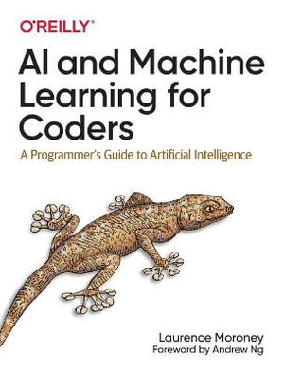
A Programmer's Guide
ML Zero to Hero, Part 1
ML Zero to Hero, Part 2

Slide 7
Let's see what happens when we try this...
Google colab...
A simple demo

